Slide 1
Towards Artificial Intelligence @GBT

Slide 2
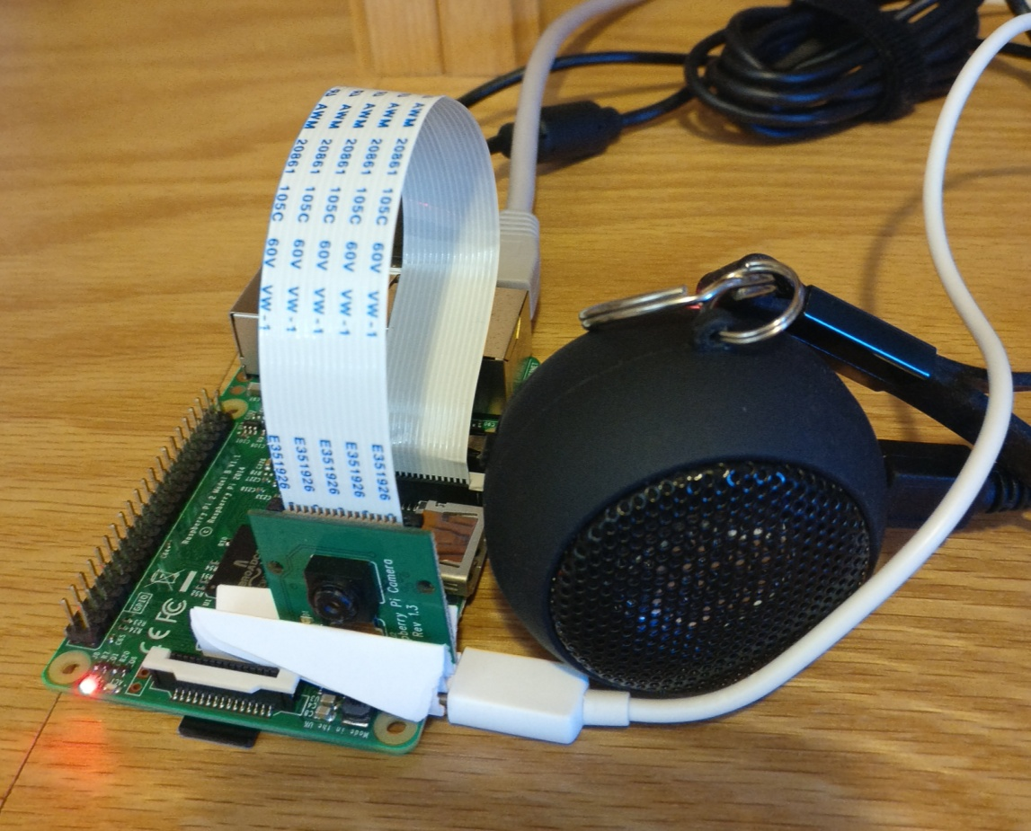
BI → Machine Learning → Deep Learning → Artificial Intelligence
Machines
SEE (amenities like pools, breakfast)
HEAR (cisco call logs for sentiment)
SPEAK (machine translation in local language)
REASON (MI, Booking bots)
TURK (CALM, quality monitors)

Slide 3
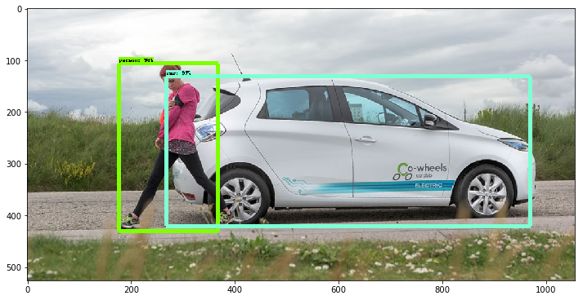
Vision
Can we spot business hoardings? How about compiling amenity lists from traveler/website pictures?
No matter what the scene and object, computers are starting to “see” and make judgments

Slide 4
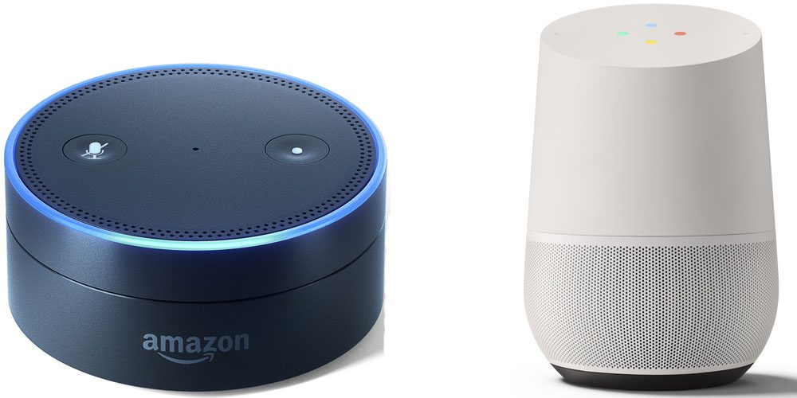
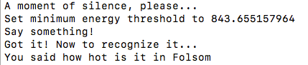
Hear
No matter what the language or intent, computers are getting good at recognizing diction and accents
Can we make automated customer sentiment analyzer for proactive duty of care?

Slide 5
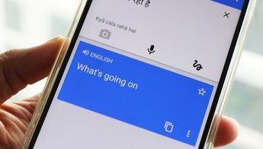

Speak
Computers are getting good at uttering speed, synthesis, and accentuation; they are not “robotic” anymore
Can we offer proactive multilingual duty of care/in-trip convenience to non native speakers?

Slide 6
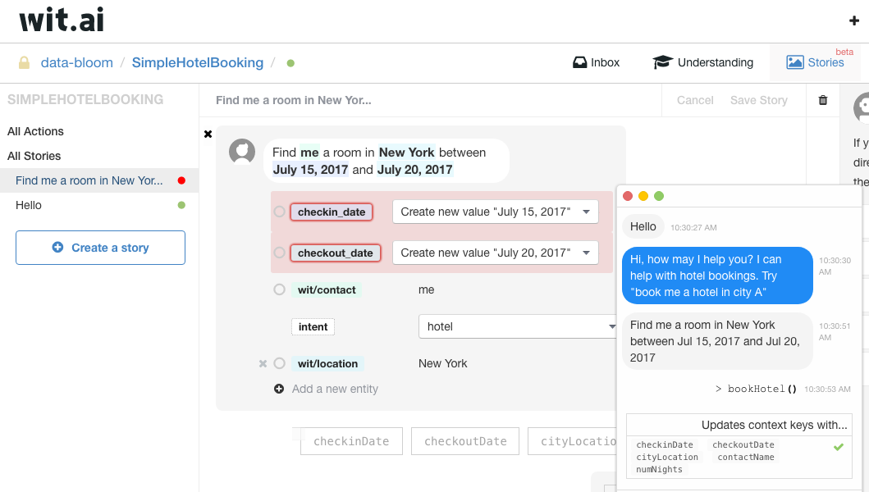
Reason
From loosely structured dialog to contextual conversations are easily accessible now through wit.ai, watson, alexa, luis, api.ai etc
Building a bot with full intent-mining, conversational agents in under 10 minutes. Can we automate MI, BI reports? Can we offer multimodal mobile experience?

Slide 7
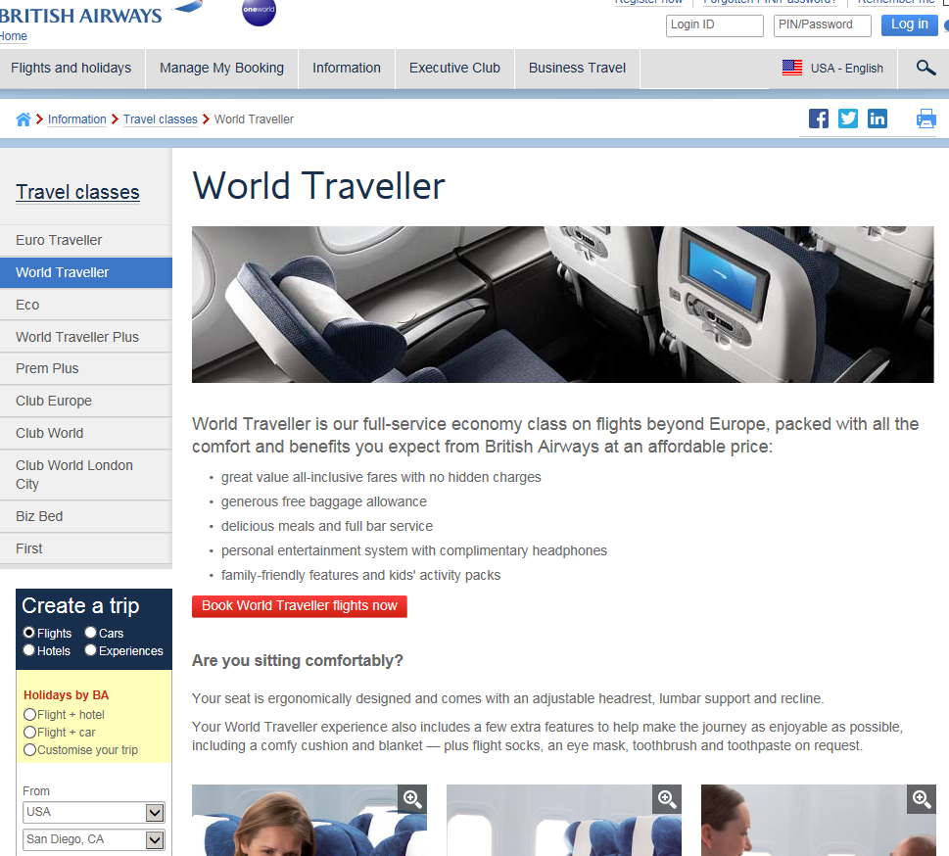
Turk
Can we spot when a crisis alert is mentioned on twitter? Or when the supplier advertises new policies? Or when state department issues new travel advisory?
Humans do not have time to keep tabs on the vast expanse of the web. Computational turks can be smart and proactive

Slide 8
Key Messages
Enough archaic BI
Embrace AI
Mission @DataScience (through 2020)
Automation, automation, automation (enterprise)
Better supplier outcomes (supplier)
Better traveler experience (traveler)
Self-service client imperatives (client)

